Slide 1

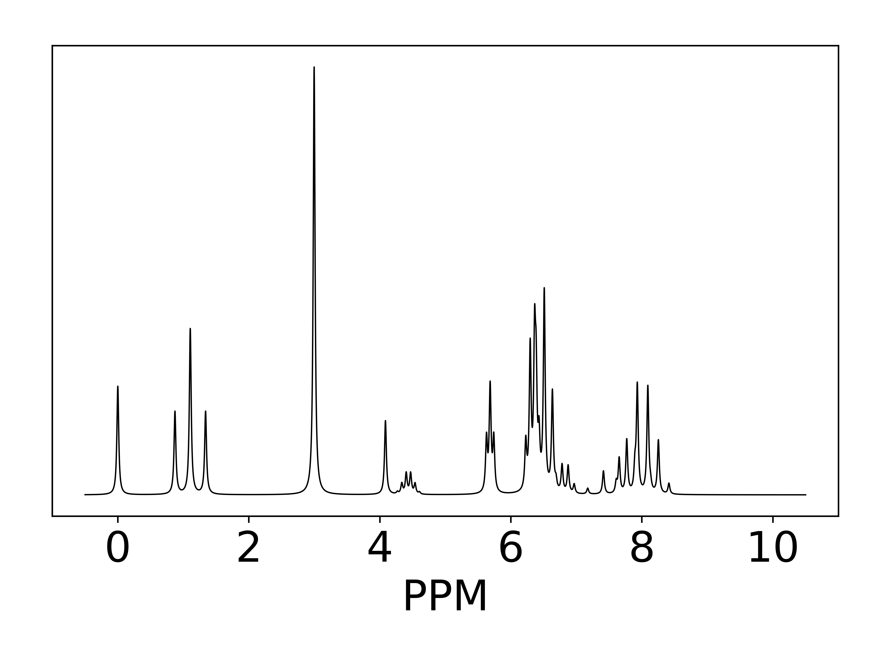
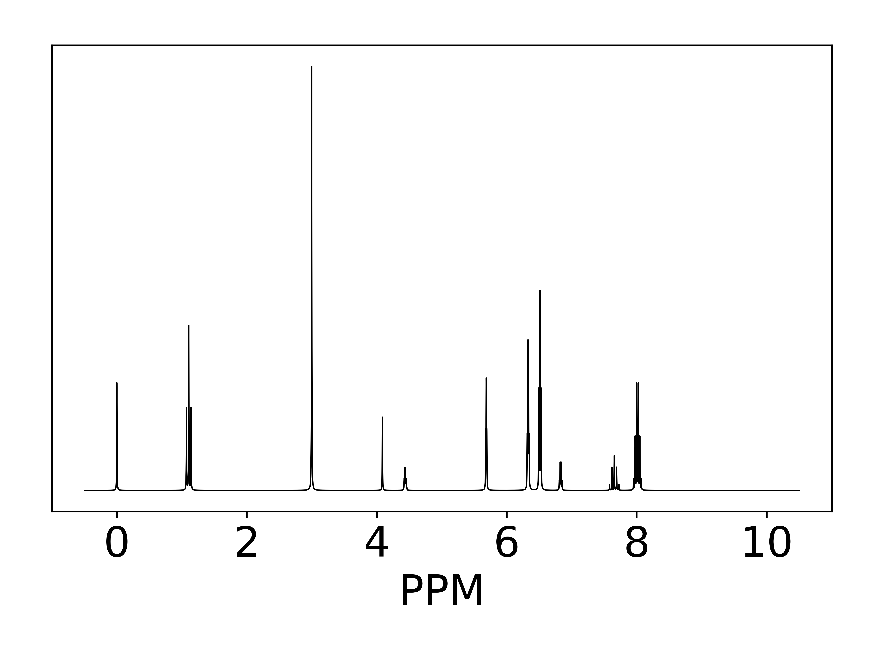

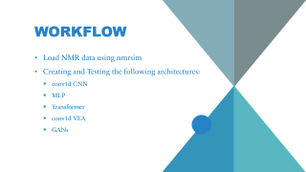
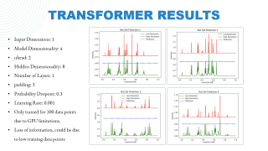
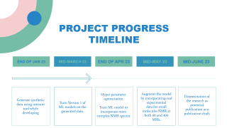
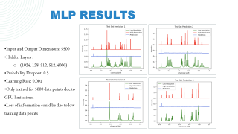
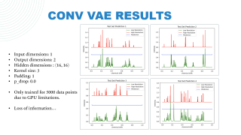
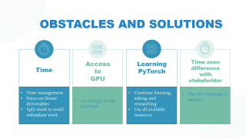
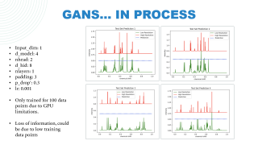
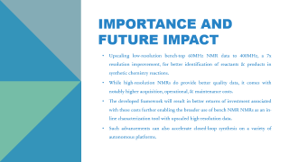
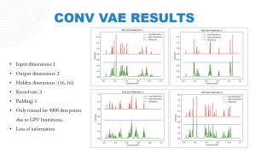
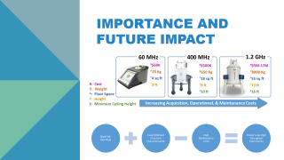

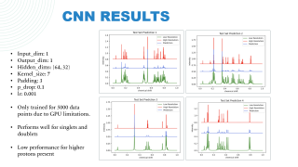
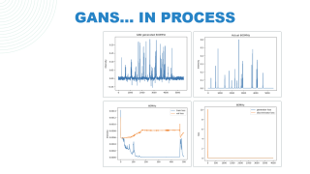
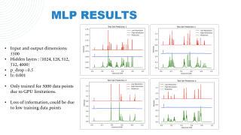
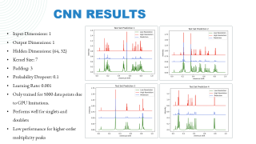
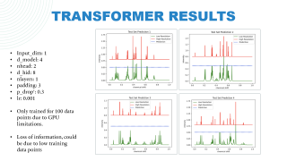
Davi Nakajima An​
Garrett Reinhard
Faiza Abdillahi
Aban Mandal
Blanca Liu
Resolut(I)on Up(S)caling f(O)r Spec(T)rosc(O)pic Im(P)lem(E)ntation​​
ISOTOPE
60 MHz
400 MHz
Notes:
Cost
Weight
Square Ft.
Maintenance
, it has other constraints to work with, maintenance cost, and repair costs, superconducting coils (cooled with liquid helium@month/nitrogen, weekly); larger footprint (own room).
Since the underlying physics of how NMR works
Once sentence about why this may be high-risk. (no one has thought about it). 60 MHz may be deceptive (if only used by itself) sometimes.
While this may not be the end, this will be an awesome start if successful.

Slide 2
Davi Nakajima An​
Garrett Reinhard
Faiza Abdillahi
Aban Mandal
Blanca Liu
Resolut(I)on Up(S)caling f(O)r Spec(T)rosc(O)pic Im(P)lem(E)ntation​​
ISOTOPE
60 MHz
400 MHz
Notes:
Cost
Weight
Square Ft.
Maintenance
, it has other constraints to work with, maintenance cost, and repair costs, superconducting coils (cooled with liquid helium@month/nitrogen, weekly); larger footprint (own room).
Since the underlying physics of how NMR works
Once sentence about why this may be high-risk. (no one has thought about it). 60 MHz may be deceptive (if only used by itself) sometimes.
While this may not be the end, this will be an awesome start if successful.

Slide 3
Davi Nakajima An​
Garrett Reinhard
Faiza Abdillahi
Aban Mandal
Blanca Liu
Resolut(I)on Up(S)caling f(O)r Spec(T)rosc(O)pic Im(P)lem(E)ntation​​
ISOTOPE
60 MHz
400 MHz
Notes:
Cost
Weight
Square Ft.
Maintenance
, it has other constraints to work with, maintenance cost, and repair costs, superconducting coils (cooled with liquid helium@month/nitrogen, weekly); larger footprint (own room).
Since the underlying physics of how NMR works
Once sentence about why this may be high-risk. (no one has thought about it). 60 MHz may be deceptive (if only used by itself) sometimes.
While this may not be the end, this will be an awesome start if successful.

Slide 4
Davi Nakajima An​
Garrett Reinhard
Faiza Abdillahi
Aban Mandal
Blanca Liu
Resolut(I)on Up(S)caling f(O)r Spec(T)rosc(O)pic Im(P)lem(E)ntation​​
ISOTOPE
60 MHz
400 MHz
Notes:
Cost
Weight
Square Ft.
Maintenance
, it has other constraints to work with, maintenance cost, and repair costs, superconducting coils (cooled with liquid helium@month/nitrogen, weekly); larger footprint (own room).
Since the underlying physics of how NMR works
Once sentence about why this may be high-risk. (no one has thought about it). 60 MHz may be deceptive (if only used by itself) sometimes.
While this may not be the end, this will be an awesome start if successful.

Slide 5
Davi Nakajima An​
Garrett Reinhard
Faiza Abdillahi
Aban Mandal
Blanca Liu
Resolut(I)on Up(S)caling f(O)r Spec(T)rosc(O)pic Im(P)lem(E)ntation​​
ISOTOPE
60 MHz
400 MHz
Notes:
Cost
Weight
Square Ft.
Maintenance
, it has other constraints to work with, maintenance cost, and repair costs, superconducting coils (cooled with liquid helium@month/nitrogen, weekly); larger footprint (own room).
Since the underlying physics of how NMR works
Once sentence about why this may be high-risk. (no one has thought about it). 60 MHz may be deceptive (if only used by itself) sometimes.
While this may not be the end, this will be an awesome start if successful.

Slide 6
Davi Nakajima An​
Garrett Reinhard
Faiza Abdillahi
Aban Mandal
Blanca Liu
Resolut(I)on Up(S)caling f(O)r Spec(T)rosc(O)pic Im(P)lem(E)ntation​​
ISOTOPE
60 MHz
400 MHz
Notes:
Cost
Weight
Square Ft.
Maintenance
, it has other constraints to work with, maintenance cost, and repair costs, superconducting coils (cooled with liquid helium@month/nitrogen, weekly); larger footprint (own room).
Since the underlying physics of how NMR works
Once sentence about why this may be high-risk. (no one has thought about it). 60 MHz may be deceptive (if only used by itself) sometimes.
While this may not be the end, this will be an awesome start if successful.

Slide 7
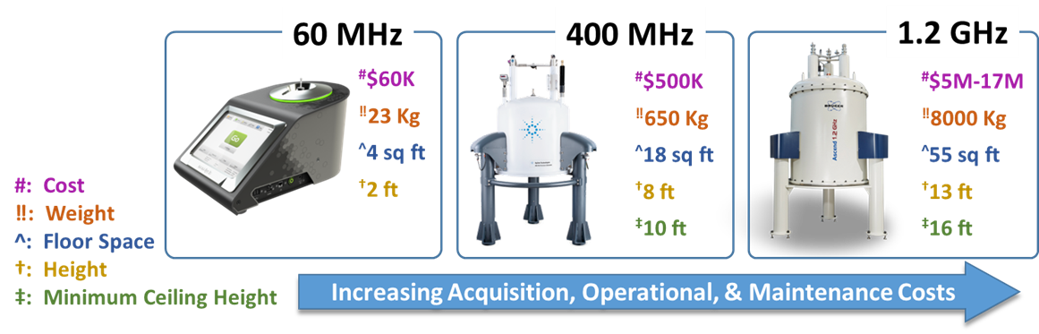
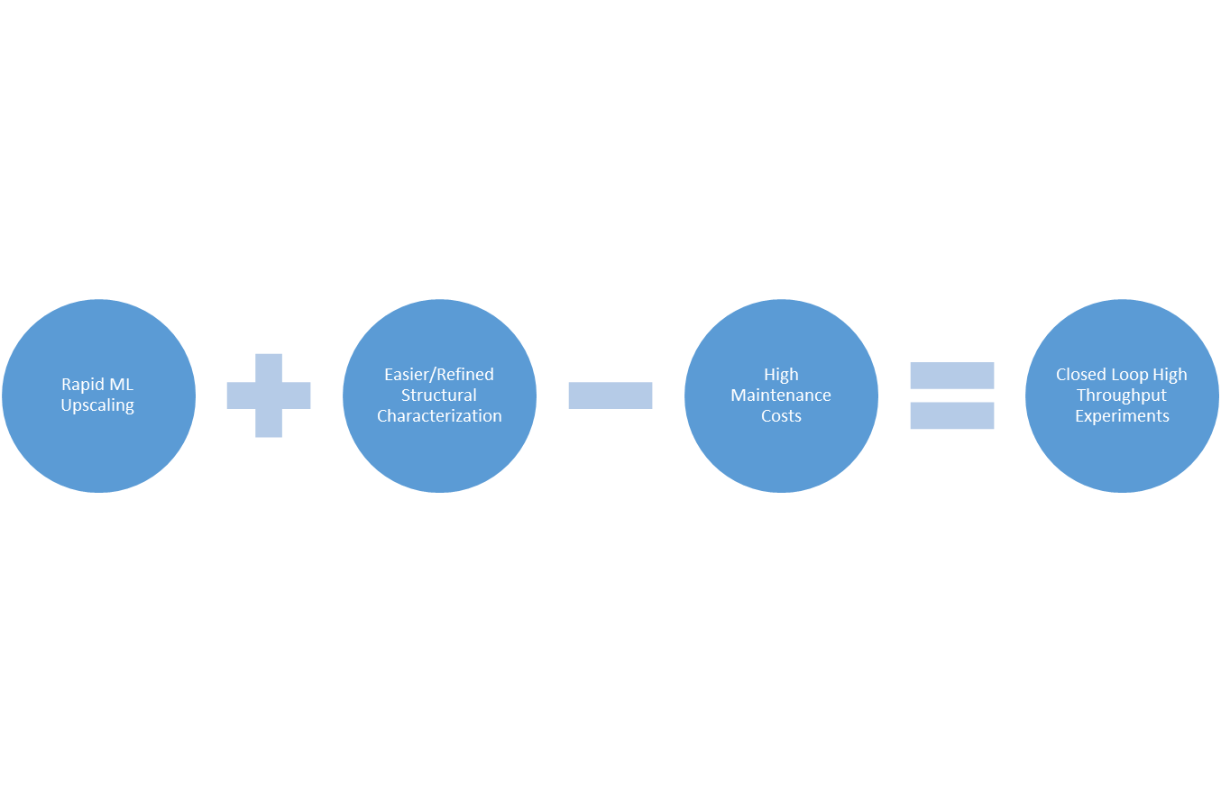
Importance and Future impact

Slide 8
Workflow
Load NMR data using nmrsim​
Creating and Testing the following architectures:
conv1d CNN
MLP
​Transformer
conv1d VAE
GANs

Slide 9
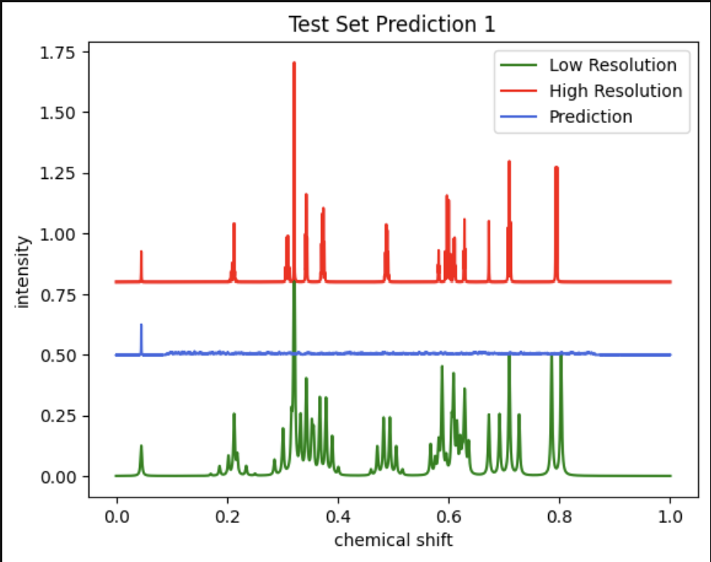
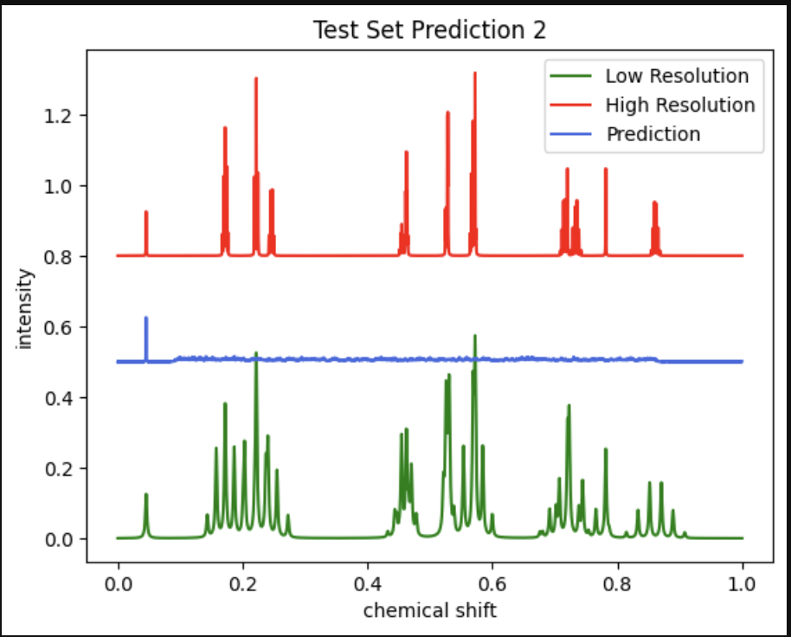
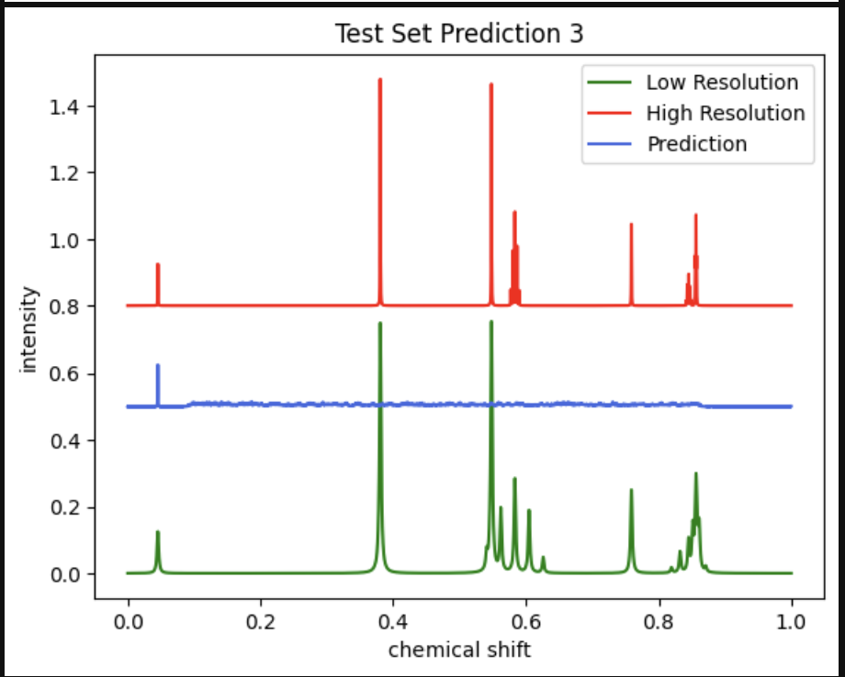
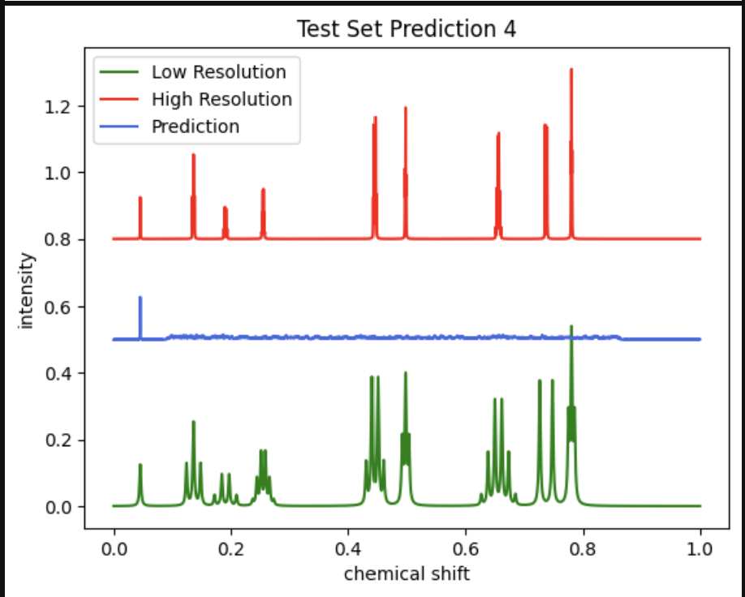
MLP results
Input and Output Dimensions: 5500
Hidden Layers :
(1024, 128, 512, 512, 4000)
Probability Dropout: 0.5
Learning Rate: 0.001
Only trained for 5000 data points due to GPU limitations.
Loss of information could be due to low training data points

Slide 10
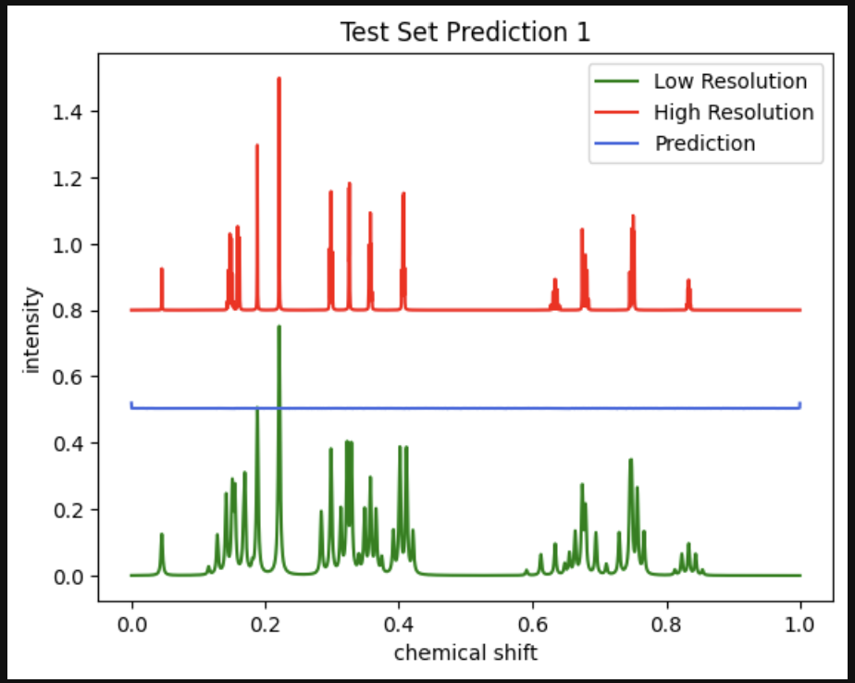
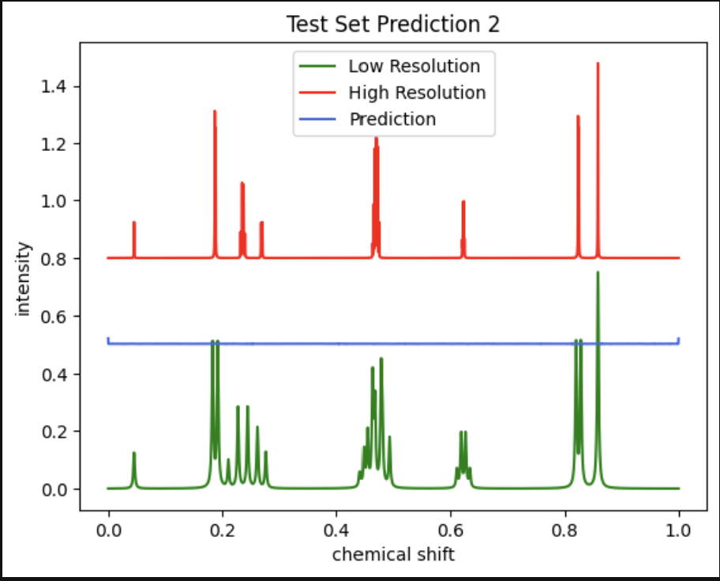
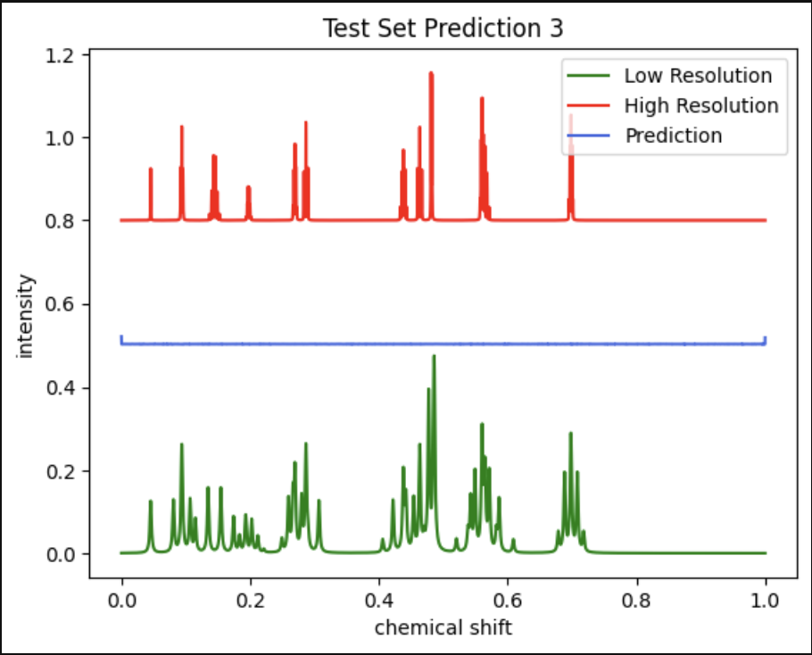
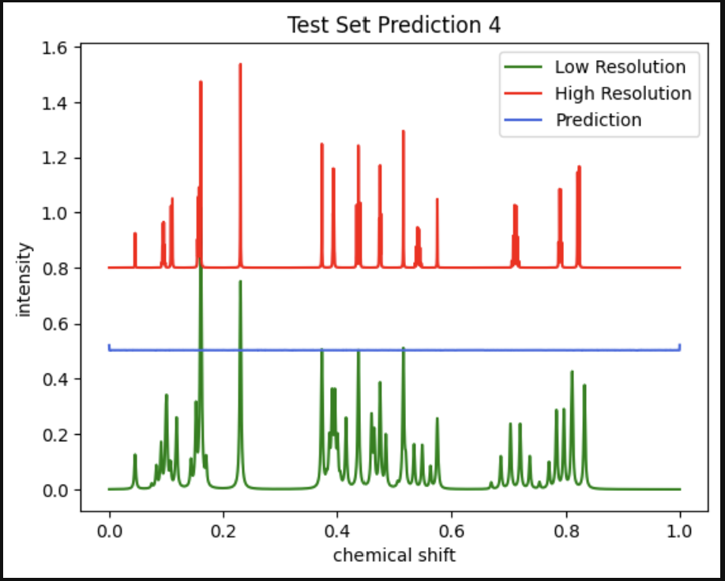
Conv vae results
Input dimensions: 1
Output dimensions: 2
Hidden dimensions : (16, 16)
Kernel size: 3
Padding: 1
Only trained for 5000 data points due to GPU limitations.
Loss of information

Slide 11
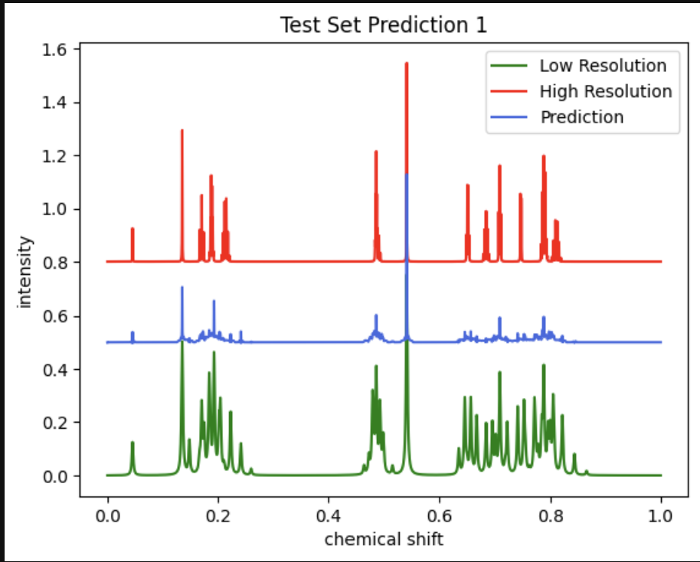
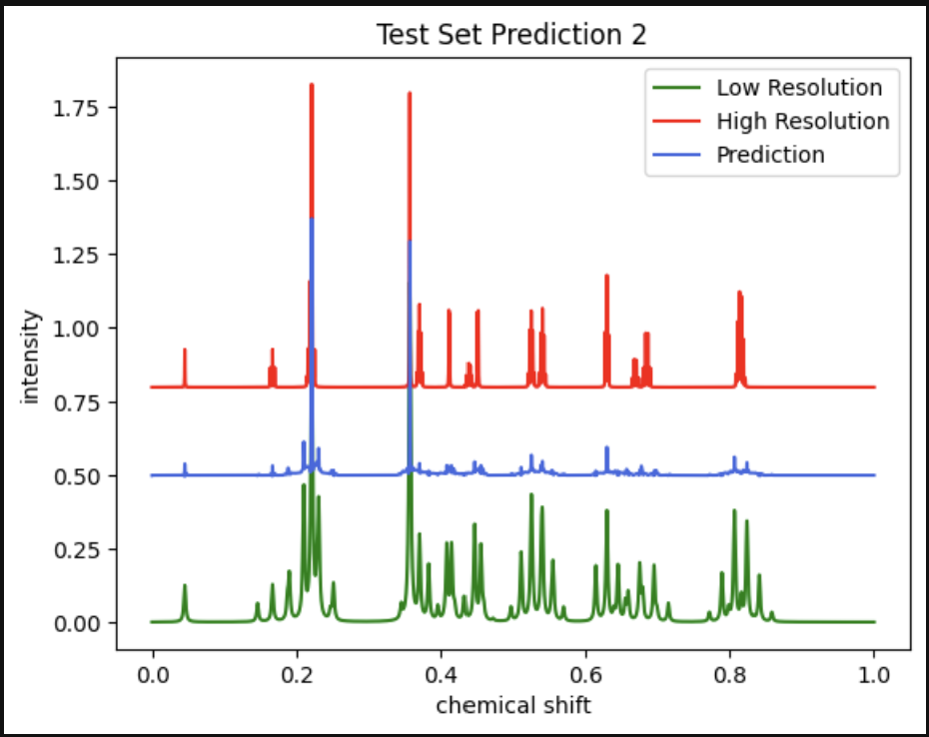
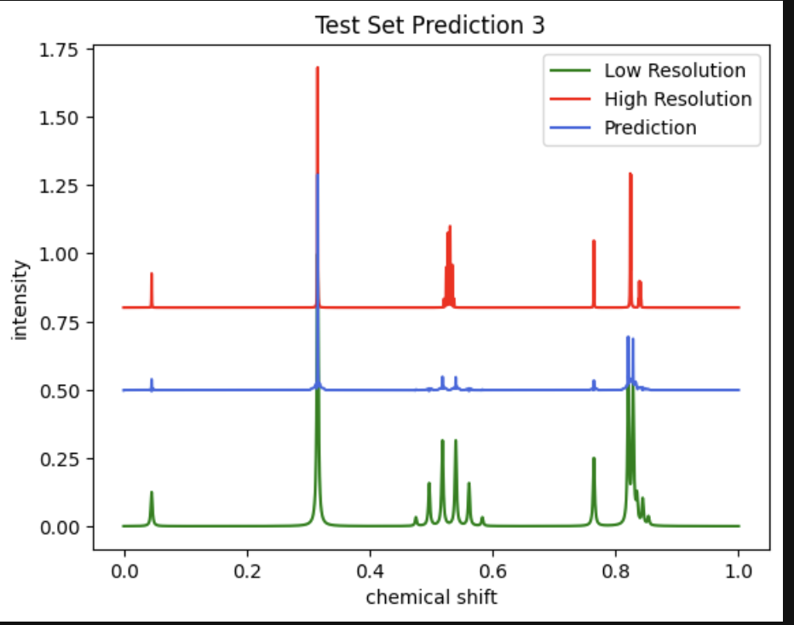
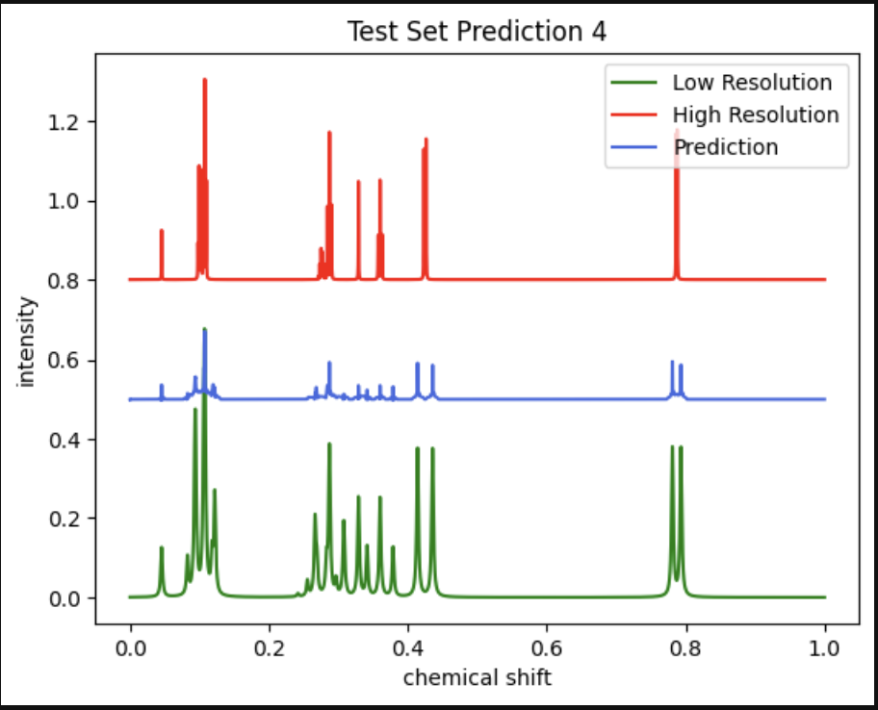
CNN results
Input Dimensions: 1
Output Dimensions: 1
Hidden Dimensions: (64, 32)
Kernel Size: 7
Padding: 3
Probability Dropout: 0.1
Learning Rate: 0.001
Only trained for 5000 data points due to GPU limitations.
Performs well for singlets and doublets
Low performance for higher-order multiplicity peaks

Slide 12
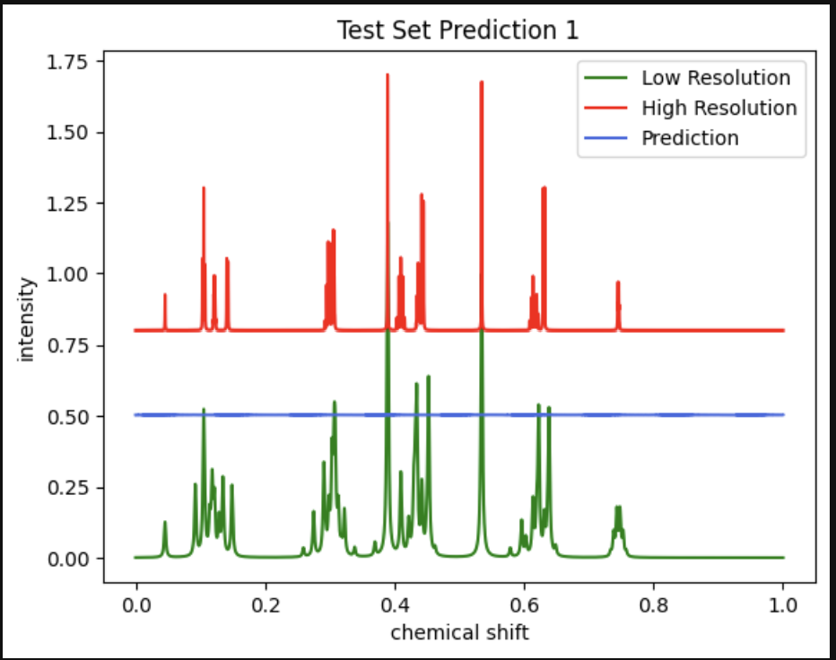
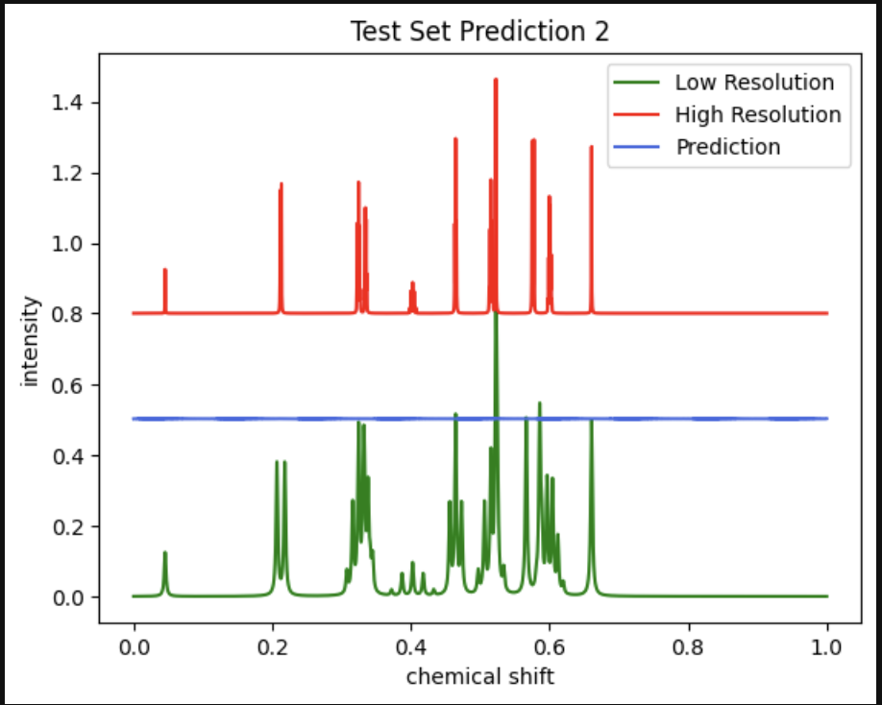
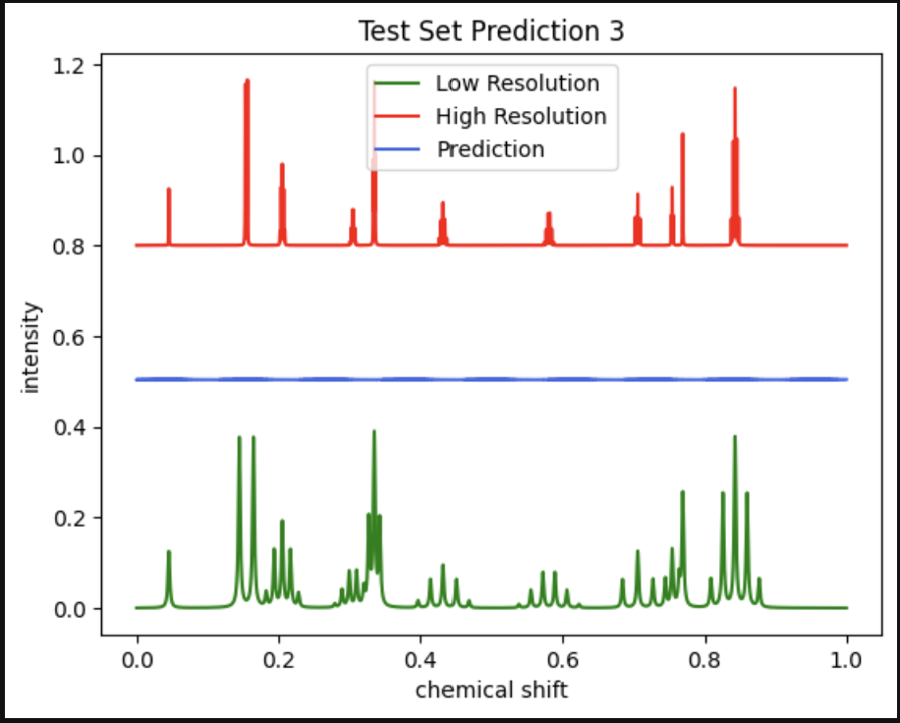
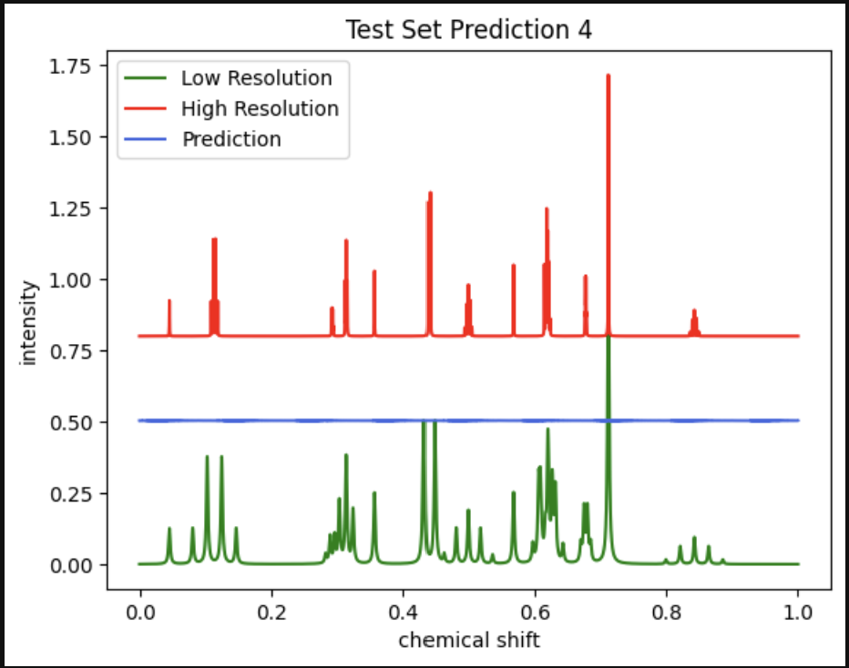
transformer results
Input Dimensions: 1
Model Dimensionality: 4
nhead: 2
Hidden Dimensionality: 8
Number of Layers: 1
padding: 3
Probability Dropout: 0.3
Learning Rate: 0.001
Only trained for 100 data points due to GPU limitations.
Loss of information, could be due to low training data points

Slide 13
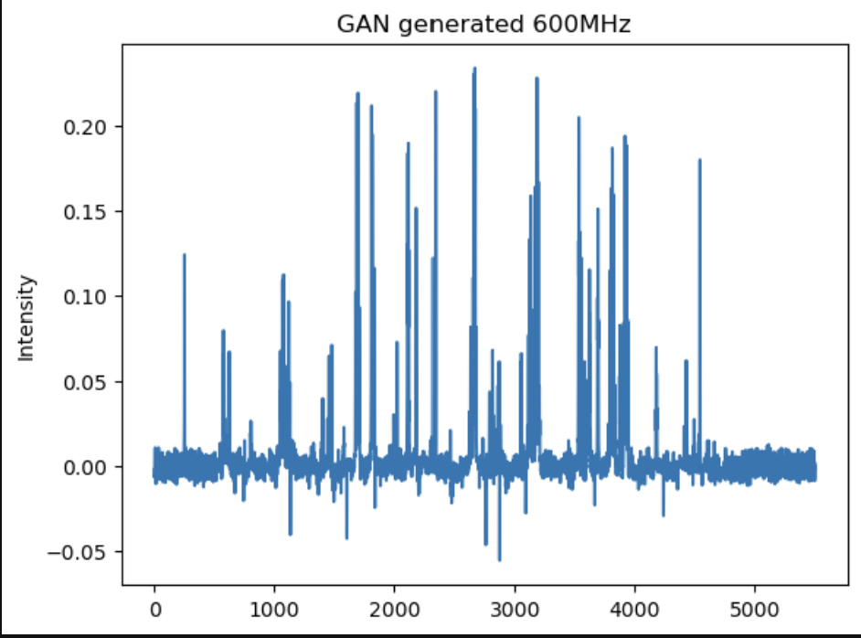
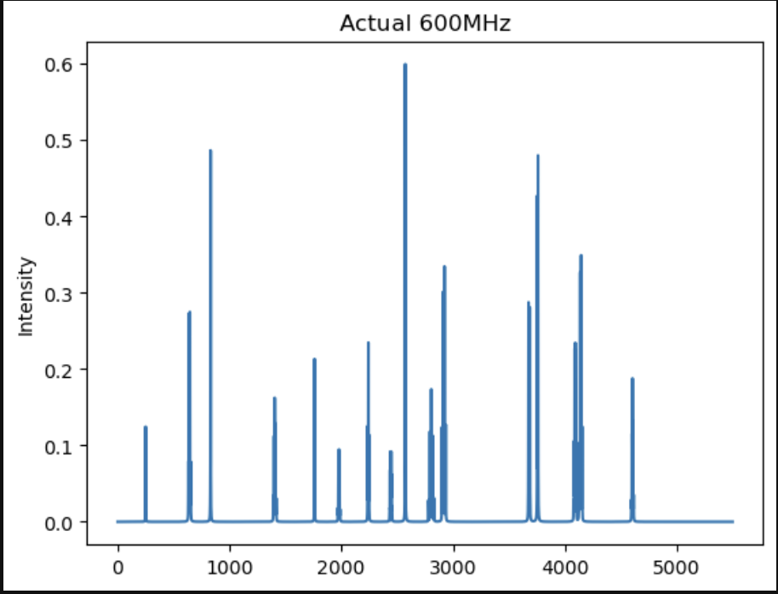
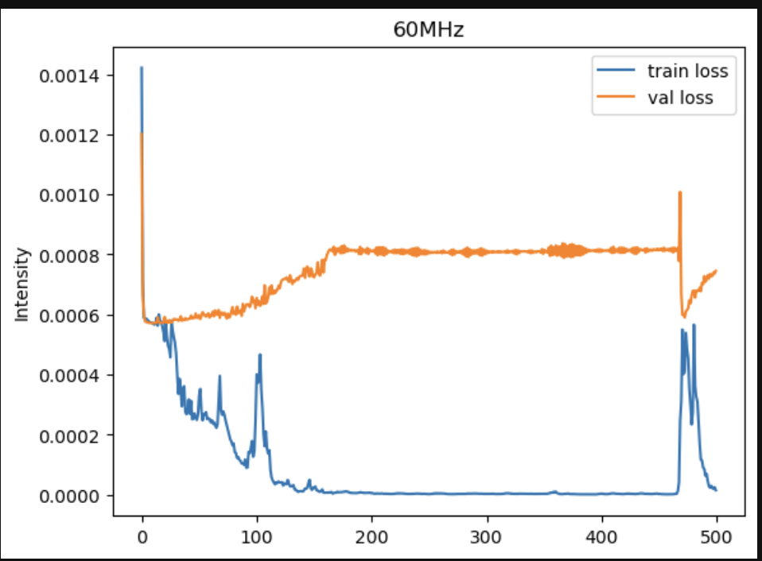
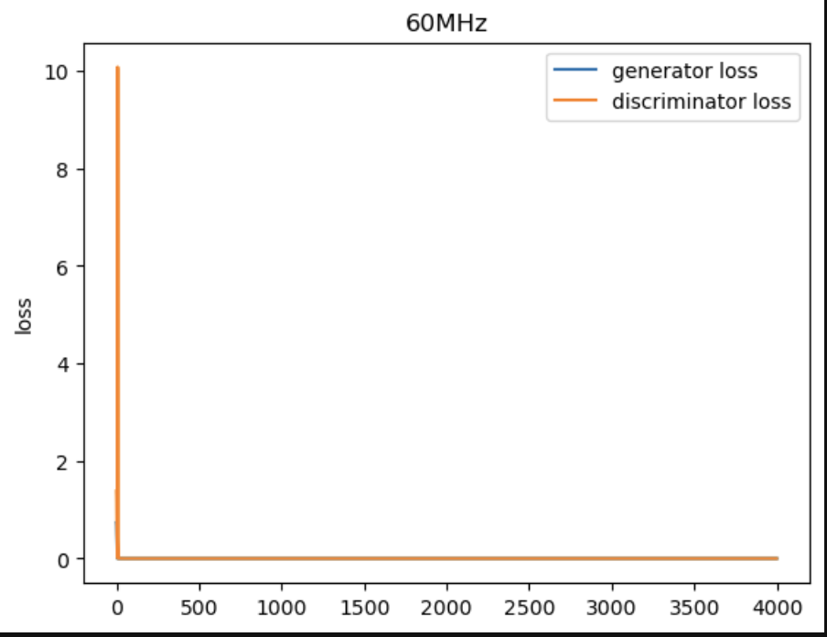
GANs… in process

Slide 14




Obstacles and solutions
Access
to
GPU
Learning PyTorch
Time zone difference with stakeholder
Time
Time management
Focus on future deliverables
Split work to avoid redundant work
Continue learning, asking, and researching
Use all available resources
Plan for meetings in advance
Use Google Colab
Use Hyak

Slide 15

Project progress TIMELINE
End of jan 23
Mid-march 23
End of apr 23
Mid-may 23
Mid-June 23
Hyper-parameter optimization
Train ML model to incorporate more complex NMR spectra
Augment the model by incorporating real experimental
data for small molecules NMR at both 60 and 400 MHz.
Dissemination of the research as potential publication as a
publication draft.
Generate synthetic data using nmrsim tool while developing
Train Version 1 of ML models on the generated data.

